Slide 1
Fashion MNIST Images Prediction
Student: Shreyams Jain
Mentor: Karel Roeland

Slide 2
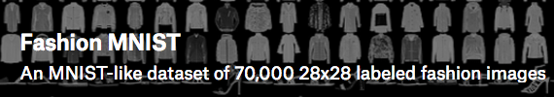
Objectives
The objective is performing multi class classification on a Fashion – MNIST dataset containing Fashion Images. The goal of the project is to be able to make prediction on images given the pixels of each image. The different classes are T-shirt/top, Trouser, Pullover, Dress, Coat, Sandal, Shirt, Sneaker, Bag and Ankle boot.

Slide 3


Intro
The Machine Learning model was created on the Fashion images dataset. This model will be able to make predictions given an image.
Data Used A Fashion MNIST dataset containing 60000 images in pixels format.
Clients Major clients would be companies selling 3rd Party goods like Amazon, ebay
Approach Create multiple neural network models for predicting images.

Slide 4
Clients:¶
Fashion and Apparel Industry: The Apparel Industry can use the model to predict the type of dress given the image of the dress. Also the e commerce apparel industry can use this to predict images from third party sellers where the company themselves do not have access to the dress. Given a grayscale image of the dress, the companies can use the model to make predictions.
The model is up and ready to plug and play predicting gray scale apparel images. It is also open to improvement. Just some minor tweaks can be made to the model to improve its results.
This model can be used by clients like:
Amazon
Ebay
Zalando
Bestbuy
Flipkart
These companies need to also sell products from 3rd party vendors apart from the goods produced by them. For ex, ebay is a marketplace for selling goods by third party vendors. Hence, to recognize what kind of product is being sold by the vendors, this model can be used to classify products.

Slide 5
Data:
Fashion-MNIST is a dataset of Zalando's article images—consisting of a training set of 60,000 examples and a test set of 10,000 examples. Each example is a 28x28 grayscale image, associated with a label from 10 classes. Zalando intends Fashion-MNIST to serve as a direct drop-in replacement for the original MNIST dataset for benchmarking machine learning algorithms. It shares the same image size and structure of training and testing splits.
Kaggle dataset: https://www.kaggle.com/zalando-research/fashionmnist
Initially setting up an Amazon GPU server for high computational tasks that needs to be performed for this project. Then perform some data analysis to see how the pixel data looks like for different classes of images. Use Deep Learning Libraries like Keras and TensorFlow to perform image recognition and make predictions.

Slide 6
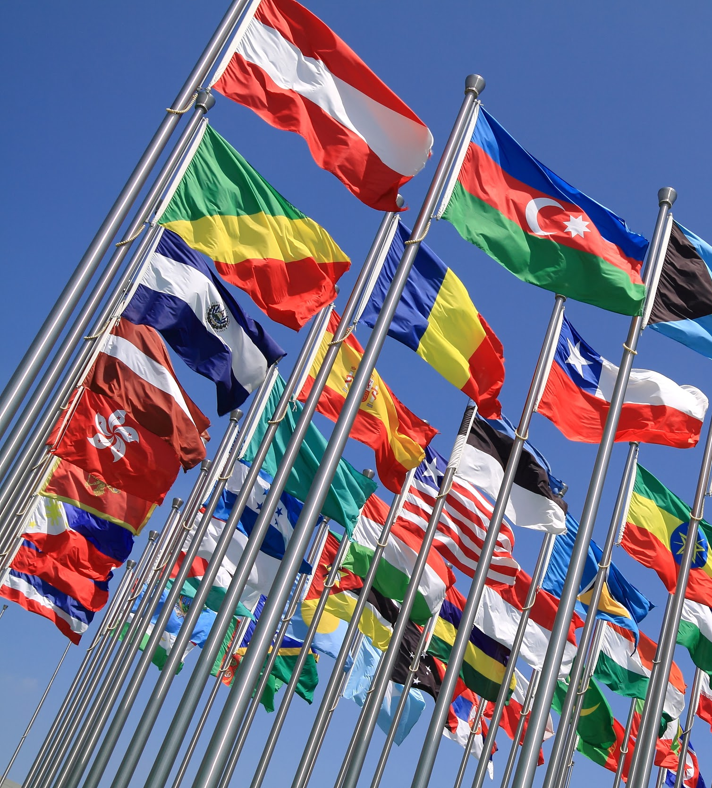
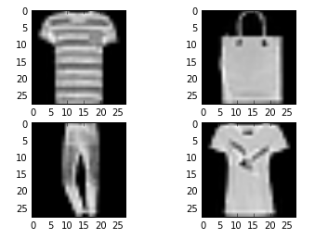
To the right is the set of 4 images from the training set.
The one on the top left is a t-shirt.
The one in the bottom left is a pant or trouser.
The one on the top right is a purse.
The one on the bottom right is a ladies T-shirt
Tip
Don’t wait till the end of the presentation to give the bottom line.
Reveal your product or idea (in this case a translation app) up front.

Slide 7
Model 1:
We have a first hidden layer is a convolutional layer called a Convolution2D. The layer has 32 feature maps, which with the size of 5 × 5 and an activation function relu also known as rectifier. This is the input layer, expecting images with the structure outline above.
Next we define a pooling layer that takes the maximum value called MaxPooling2D. It is configured with a pool size of 2 × 2.
The next layer is a regularization layer using dropout called Dropout. It is configured to randomly exclude 20% of neurons in the layer in order to reduce overfitting.
Next is a layer that converts the 2D matrix data to a vector called Flatten. It allows the output to be processed by standard fully connected layers.
Next a fully connected layer with 128 neurons and rectifier activation function is used.
Finally, the output layer has 10 neurons for the 10 classes and a softmax activation function to output probability-like predictions for each class.

Slide 8
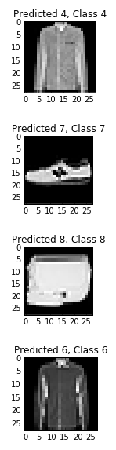
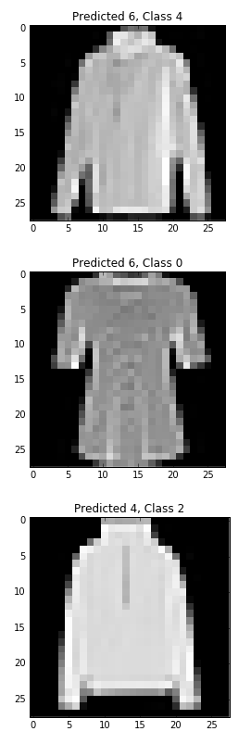
With Model 1 we are achieving an accuracy of 91%.
The precision, recall and f score is at 0.91
To the right, we have a sample of correctly and incorrectly predicted images.
Correct Incorrect

Slide 9
Model 2: A larger CNN
Convolutional layer with 30 feature maps of size 5 × 5.
Pooling layer taking the max over 2 × 2 patches.
Convolutional layer with 15 feature maps of size 3 × 3.
Pooling layer taking the max over 2 × 2 patches.
Dropout layer with a probability of 20%.
Flatten layer.
Fully connected layer with 128 neurons and rectifier activation.
Fully connected layer with 50 neurons and rectifier activation.
Output layer.

Slide 10
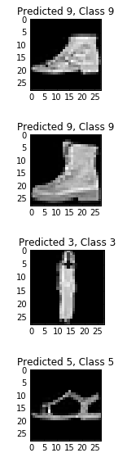
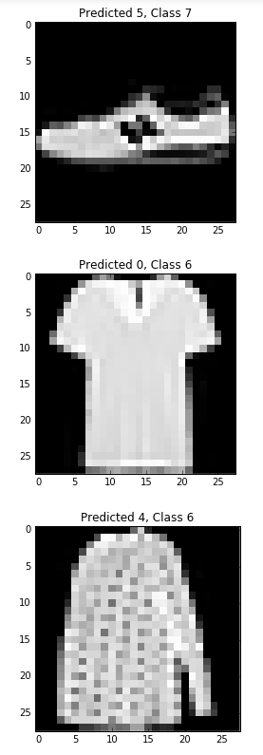
With Model 1 we are achieving an accuracy of 89%.
The precision, recall and f score is at 0.89
To the right, we have a sample of correctly and incorrectly predicted images.
Correct Incorrect

Slide 11
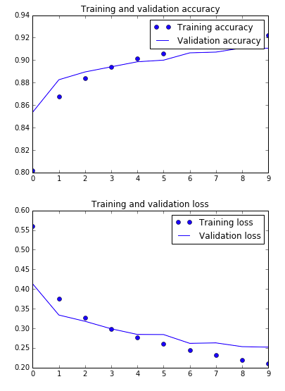
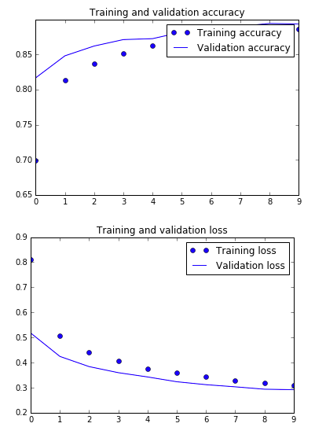
Training and Validation Accuracy and Loss for both models:
Model 1 Model 2

Slide 12
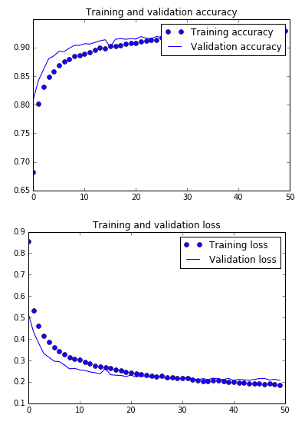
Model 3:
Convolutional layer with 32 feature maps of size 3 x 3.
Pooling layer taking the max over 2 × 2 patches.
Dropout layer with a probability of 25%.
Convolutional layer with 64 feature maps of size 3 × 3.
Pooling layer taking the max over 2 × 2 patches.
Dropout layer with a probability of 25%.
Convolutional layer with 128 feature maps of size 3 × 3.
Dropout layer with a probability of 40%.
Flatten layer.
Fully connected layer with 128 neurons and rectifier activation.
Dropout layer with a probability of 30%.
Output layer.

Slide 13
Conclusion:
We initially started off with building a simple neural network model for making the predictions. With the simple model after training and validating the model, we were able to achieve an accuracy of 91% and a precision, recall and f1-score of 0.91 which was pretty good.
The Test loss for baseline model is around 0.25 which is pretty decent and we have a test accuracy of 0.91 as explained earlier. This explains that the model is 91% accurate in its predictions.
Similarly, we created another convolution neural network to check if we can achieve a better accuracy. With this larger model, we trained and validated the model for accuracy. When we checked the larger model was able to get an accuracy of 89% and a precision, recall and f score of 0.89.
The Test loss for larger model 0.29 which is a little more than what we achieved in our simpler model. The Test accuracy for larger model 0.89 as explained earlier. This is also lower than what we achieved in the simpler model.
The model is now ready to make predictions on any Grayscale Image Dataset. If the same model is trained on another training dataset with different labels, it will still be able to make good predictions, but it totally depends on the type of images being classified and the dataset.

